Slide 1
Sensors and the Internet of Things
G. Andrew Duthie
Chief Consultant – Devhammer Enterprises LLC
http://devhammer.net
devhammer@live.com

Slide 2
Disclaimer
I do IoT for fun.
While I have designed PCBs, and even sold a few Gadgeteer modules along the way, I still consider myself to be more enthusiast than expert in this area.
As such, take all my suggestions and advice in that context. If you need to design highly secure or highly scalable IoT systems, you will need to do additional research on those topics.

Slide 3
Agenda
What is IoT?
What kind of communications are we talking about?
Architecural options
A brief discussion of Security
Communicating inside the the firewall
Communicating with the cloud
Summary

Slide 4
What is IoT?
A buzzword
Marketing term
A term of convenience for describing a broad array of connected device scenarios, from industrial controls and sensors, to home automation and gadgets

Slide 5
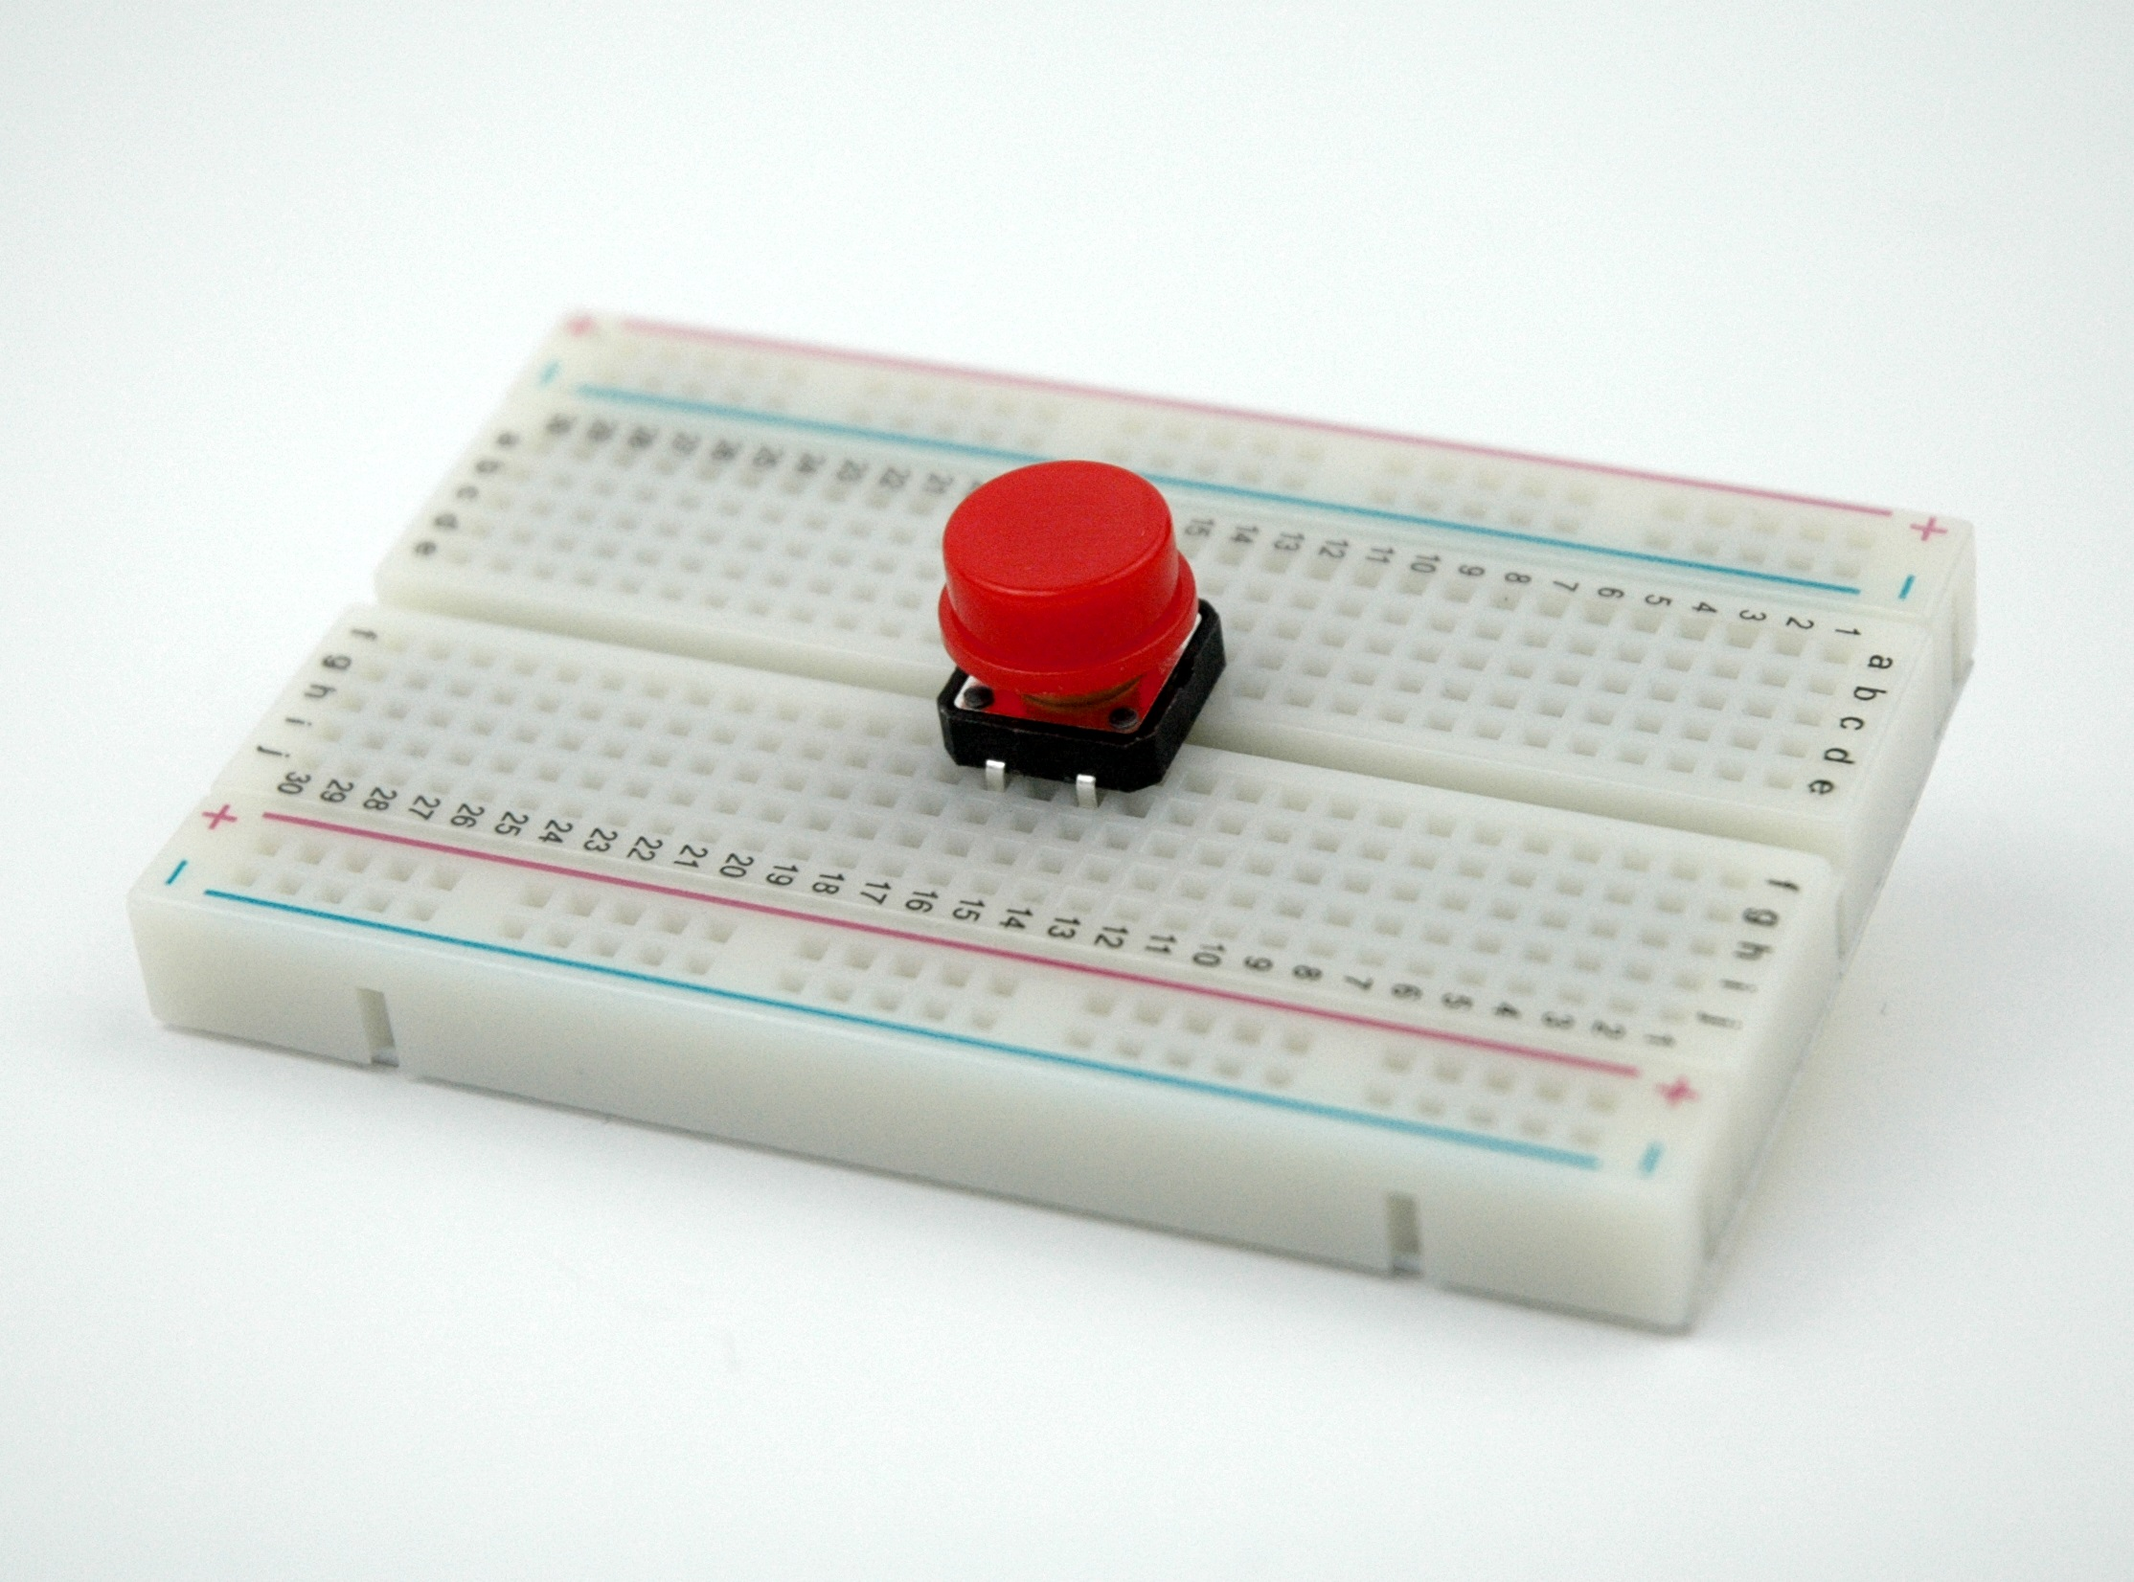
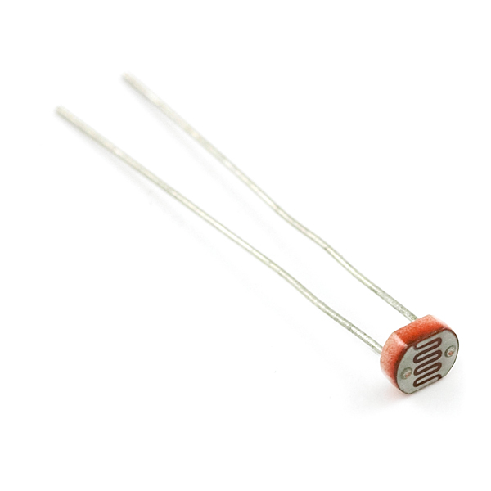
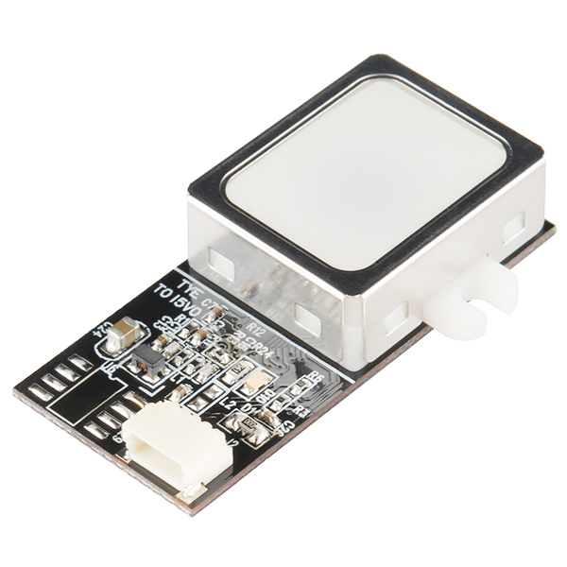
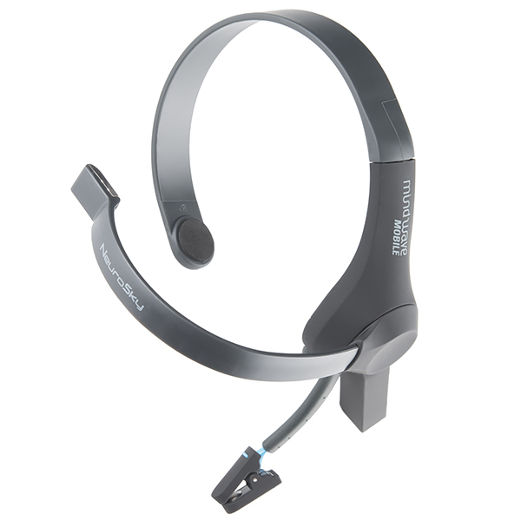
About Sensors
Come in all shapes and sizes
From simple to complex
Allow devices to measure the world around them, and respond appropriately

Slide 6
Signal Types
Basic: Analog or Digital
Analog - usually measured as a value from ground (0V) to supply voltage (typically 3.3V or 5V)
Digital – On or Off, or in microcontroller terms, HIGH or LOW
Higher-level Protocols
I2C, Serial Peripheral Interface (SPI), OneWire, etc.
Provide a means of communicating more, or more complex, data efficiently.

Slide 7
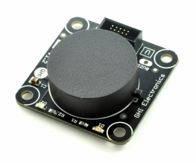
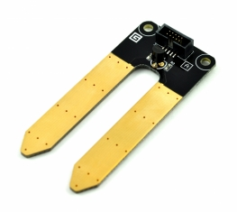
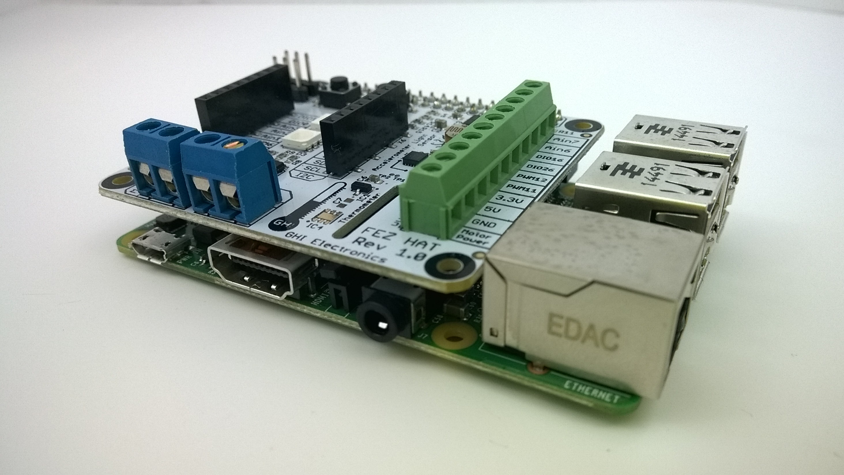
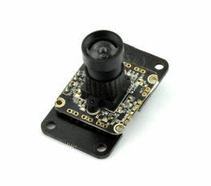
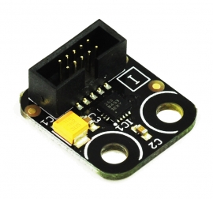
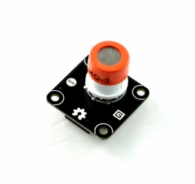
Hardware Options for Makers
A wealth of choices:
Arduino – probably the best-known microcontroller platform
Raspberry Pi – cheap, single-board computing, with hackability
.NET Micro Framework and Gadgeteer – C#, Visual Studio, and Rapid Prototyping
Windows 10 IoT Core – Bring together hardware and app UIs built with XAML and C#.
Boards and Modules
FEZ HAT and FEZ Cream for Raspberry Pi 2
Many Gadgeteer modules supported

Slide 8
DEMO
Sensor EXAMPLES – Gadgeteer and BrainPad

Slide 9
What Kind of Communication?
Inside the firewall
Aggregation of data
Low-power devices
Many protocols (serial, CAN, I²C, SPI, etc.)
Outside the firewall
Gateways
Multiple protocols, techniques and architectures
MQTT, AQMP, HTTP/2, etc.
When choosing protocols and architectures, it’s important to consider the volume of data, and the number of devices.
Caching data locally can help with scale.
Using services like Azure Service Bus Event Hubs can provide massive scale, and the ability to easily integrated analytics on the received data.

Slide 10
Architectural Options
Kinds of systems:
Every device connected (expensive, security implications)
Gateway pattern (cheaper devices, fewer connected, data can be buffered)
Others
Technologies:
Web API, SignalR, etc.
MQTT (brokered queued communication)
AMQP (supported by Azure Service Bus)
Device types:
Sensors/Controllers
Edge (gateway) Devices

Slide 11
About Security
Q: When should you think about security?
A: ALWAYS!!!
Put on a black hat when designing devices or device architectures…hack yourself first!
Not every device needs an IP address, and you should think carefully before making a device into a server
Keeping some devices dumb (i.e. serial, IR, or other non-IP communications) can reduce attack surface
Threats to consider:
Physical access – if an attacker can touch it, they can own it
Wireless access – all wireless access should be carefully secured
Poor network segmentation – don’t put your sensors on the same network as your cash registers!

Slide 12
Inside the Firewall
Communication between sensors and microcontroller (or RPi, etc.)
Protocols (Serial, CAN, I²C, SPI, USB, Digital & Analog I/O etc.)
Generally short distance
Mostly used in wired scenarios (some WiFi & BT modules act as Serial devices)
Communication/control between devices
Serial (short distance)
IR (line-of-sight)
Bluetooth (medium distance)

Slide 13
DEMO
Serial, IR, and Bluetooth

Slide 14
Living on the Edge
Edge or Gateway devices are typically IP-based
Ethernet or WiFi
Leverage protocols built on top of HTTP:
MQTT – Message Queuing Telemetry Transport
Lightweight, pub/sub model
Easy to use in NETMF via the M2Mqtt nuget package
AMQP – Advanced Message Queuing Protocol
Supported by Azure Service Bus
Libraries available for NETMF
Both MQTT and AMQP are OASIS standards

Slide 15
DEMO
Connect THE DOTS

Slide 16
Summary
IoT has been around for a while, but communication with small devices is getting easier all the time
Be sure to take security into consideration when choosing how to communicate with sensors and devices. Hack yourself first.
Consider volume of data and number of devices in choosing your architecture.
Leverage services like Azure Service Bus for massive scale.

Slide 17
Resources
GHI Gadgeteer Kits - https://www.ghielectronics.com/catalog/category/501
Gadgeteer setup steps - https://www.ghielectronics.com/support/gadgeteer
GHI Forums - https://www.ghielectronics.com/community/forum
GHI Codeshare - https://www.ghielectronics.com/community/codeshare
M2Mqtt & GnatMQ - https://m2mqtt.wordpress.com/
ConnectTheDots.io Azure Service Bus demo - https://github.com/msopentech/connectthedots

Slide 18
About Me
Consultant, Trainer, and Author
Nearly 20 years of experience across Web, desktop, mobile, and embedded development
Teammate at Linchpin People
WintellectNOW Author
Creator of http://communitymegaphone.com
ASPInsiders founding board member

Slide 19
[Demos]
Arduino Serial to Control light patterns
Gadgeteer IR Record/Playback
Gadgeteer Star BT (both Serial and BTLE)
StarBoard (because…blinkies)
Communicating via MQTT
ConnectTheDots.io demo

